Slide 1


Model Building
data
Output
Model
=
Architecture
+
Parameters
Things that can change:
Activation function
Optimizer
Hyperparameters

Slide 2
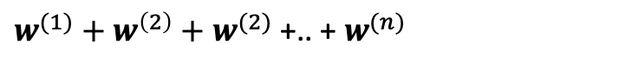
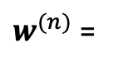
Multiclass
Output Layers
${w^{(1)}+w}^{\left(2\right)}{+ w}^{(2)}$ +.. + $w^{(n)}$
word2vec
up
0.232
Output
0.32
$w^{(n)}$ =
0.732
flat
….
0.932
0.0032
down
Input vector

Slide 3
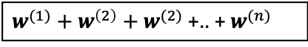
RNN – Recursive Neural Network
Output
${w^{(1)}+w}^{\left(2\right)}{+ w}^{(2)}$ +.. + $w^{(n)}$
Notes:
Since we are seq data and most importantly are text data, there is one best solution that using deep learning method especially the RNN architecture

